Slide 1
Introduction to XML
Extensible Markup Language

Slide 2
The trouble with HTML is that it was designed with humans in mind. Even without viewing the above HTML document in a browser, you and I can figure out that it is someone's postal address.
While the tags in this document tell a browser how to display this information, the tags don't tell the browser what the information is.
You and I know it's an address, but a machine doesn't.
<p><b>Mrs. Mary McGoon</b>
<br>
1401 Main Street
<br>
Anytown, NC 34829</p>

Slide 3
Need of XML
XML is used for, is to outsource data.
Rather than integrating them into the HTML document, they are stored in separate XML files.
XML stores data in plain text format, the storage is independent of your platform and your data can be exported

Slide 4
What is XML
XML stands for eXtensible Markup Language.
XML was designed to store and transport data.
XML was designed to be both human- and machine-readable.
A markup language is used to provide information about a document.
Tags are added to the document to provide the extra information.
HTML tags tell a browser how to display the document.
XML tags give a reader some idea what some of the data means.

Slide 5
Programming language
(Python,php,
.net)
Create Xml Document
Xml File
Formatted Html Document
database
Xml +css aware
browser
css file

Slide 6
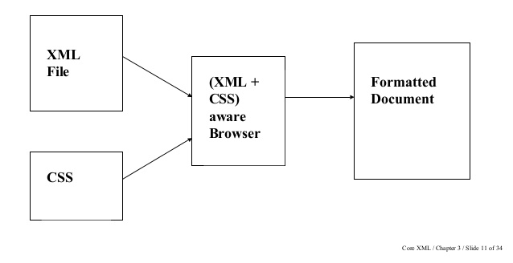
How XML works ?

Slide 7
What is XML Used For?
XML documents are used to transfer data from one place to another often over the Internet.
XML subsets are designed for particular applications.
Example : One is RSS (Rich Site Summary or Really Simple Syndication ). It is used to send breaking news bulletins from one web site to another.
A number of fields have their own subsets. These include chemistry, mathematics, and books publishing.
Most of these subsets are registered with the W3Consortium and are available for anyone’s use.

Slide 8
Advantages of XML
XML is text (Unicode) based.
  Takes up less space.
  Can be transmitted efficiently.
One XML document can be displayed differently in different media.
  Html, video, CD, DVD,
  You only have to change the XML document in order to change all the rest.
XML documents can be modularized. Parts can be reused.

Slide 9
Example of an HTML Document
<html>
<head><title>Example</title></head.
<body>
<h1>This is an example of a page.</h1>
<h2>Some information goes here.</h2>
</body>
</html>

Slide 10
Example of an XML Document
<?xml version=“1.0”/>
<address>
<name>Alice Lee</name>
<email>alee@aol.com</email>
<phone>212-346-1234</phone>
<birthday>1985-03-22</birthday>
</address>

Slide 11
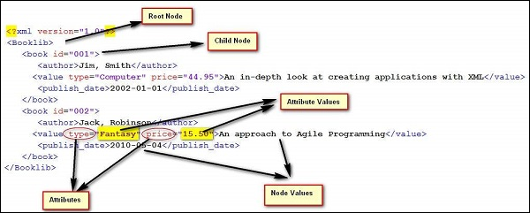

Slide 12
Difference Between HTML and XML
HTML tags have a fixed meaning and browsers know what it is.
XML tags are different for different applications, and users know what they mean.
HTML tags are used for display.
XML tags are used to describe documents and data.

Slide 13
XML Rules
Tags are enclosed in angle brackets.
Tags come in pairs with start-tags and end-tags.
Tags must be properly nested.
  <name><email>…</name></email> is not allowed.
  <name><email>…</email><name> is.
Tags that do not have end-tags must be terminated by a ‘/’.
  <br /> is an html example.

Slide 14
More XML Rules
Tags are case sensitive.
  <address> is not the same as <Address>
XML in any combination of cases is not allowed as part of a tag.
Tags may not contain ‘<‘ or ‘&’.
Tags follow Java naming conventions, except that a single colon and other characters are allowed. They must begin with a letter and may not contain white space.
Documents must have a single root tag that begins the document.

Slide 15
Encoding
XML (like Java) uses Unicode to encode characters.
Unicode comes in many flavors. The most common one used in the West is UTF-8.
UTF-8 is a variable length code. Characters are encoded in 1 byte, 2 bytes, or 4 bytes.
The first 128 characters in Unicode are ASCII.
In UTF-8, the numbers between 128 and 255 code for some of the more common characters used in western Europe, such as ã, á, å, or ç.
Two byte codes are used for some characters not listed in the first 256 and some Asian ideographs.
Four byte codes can handle any ideographs that are left.
Those using non-western languages should investigate other versions of Unicode.

Slide 16
Well-Formed Documents
An XML document is said to be well-formed if it follows all the rules.
An XML parser is used to check that all the rules have been obeyed.
Recent browsers such as Internet Explorer 5 and Netscape 7 come with XML parsers.
Parsers are also available for free download over the Internet. One is Xerces, from the Apache open-source project.
Java 1.4 also supports an open-source parser.

Slide 17
Expanded Example
<?xml version = “1.0” ?>
<address>
<name>
<first>Alice</first>
<last>Lee</last>
</name>
<email>alee@aol.com</email>
<phone>123-45-6789</phone>
<birthday>
<year>1983</year>
<month>07</month>
<day>15</day>
</birthday>
</address>

Slide 18
XML Files are Trees
address
name
email
phone
birthday
first
last
year
month
day

Slide 19
XML Trees
An XML document has a single root node.
The tree is a general ordered tree.
  A parent node may have any number of children.
  Child nodes are ordered, and may have siblings.
Preorder traversals are usually used for getting information out of the tree.

Slide 20
Validity
A well-formed document has a tree structure and obeys all the XML rules.
A particular application may add more rules in either a DTD (document type definition) or in a schema.
Many specialized DTDs and schemas have been created to describe particular areas.
These range from disseminating news bulletins (RSS) to chemical formulas.
DTDs were developed first, so they are not as comprehensive as schema.

Slide 21
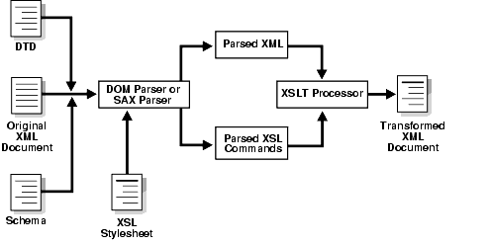
How DTD works ?

Slide 22
Document Type Definitions
A DTD describes the tree structure of a document and something about its data.
There are two data types, PCDATA and CDATA.
  PCDATA is parsed character data.
  CDATA is character data, not usually parsed.
A DTD determines how many times a node may appear, and how child nodes are ordered.

Slide 23
DTD for address Example
<!ELEMENT address (name, email, phone, birthday)>
<!ELEMENT name (first, last)>
<!ELEMENT first (#PCDATA)>
<!ELEMENT last (#PCDATA)>
<!ELEMENT email (#PCDATA)>
<!ELEMENT phone (#PCDATA)>
<!ELEMENT birthday (year, month, day)>
<!ELEMENT year (#PCDATA)>
<!ELEMENT month (#PCDATA)>
<!ELEMENT day (#PCDATA)>

Slide 24
Schemas
Schemas are themselves XML documents.
They were standardized after DTDs and provide more information about the document.
They have a number of data types including string, decimal, integer, boolean, date, and time.
They divide elements into simple and complex types.
They also determine the tree structure and how many children a node may have.

Slide 25
Schema for First address Example
<?xml version="1.0" encoding="ISO-8859-1" ?>
<xs:schema xmlns:xs="http://www.w3.org/2001/XMLSchema">
<xs:element name="address">
<xs:complexType>
<xs:sequence>
<xs:element name="name" type="xs:string"/>
<xs:element name="email" type="xs:string"/>
<xs:element name="phone" type="xs:string"/>
<xs:element name="birthday" type="xs:date"/>
</xs:sequence>
</xs:complexType>
</xs:element>
</xs:schema>

Slide 26
Explanation of Example Schema
<?xml version="1.0" encoding="ISO-8859-1" ?>
ISO-8859-1, Latin-1, is the same as UTF-8 in the first 128 characters.
<xs:schema xmlns:xs="http://www.w3.org/2001/XMLSchema">
www.w3.org/2001/XMLSchema contains the schema standards.
<xs:element name="address">
<xs:complexType>
This states that address is a complex type element.
<xs:sequence>
This states that the following elements form a sequence and must come in the order shown.
<xs:element name="name" type="xs:string"/>
This says that the element, name, must be a string.
<xs:element name="birthday" type="xs:date"/>
This states that the element, birthday, is a date. Dates are always of the form yyyy-mm-dd.

Slide 27
A Style Sheet to Transform address.xml
<?xml version="1.0" encoding="ISO-8859-1"?>
<xsl:stylesheet version="1.0" xmlns:xsl="http://www.w3.org/1999/XSL/Transform">
<xsl:template match="address">
<html><head><title>Address Book</title></head>
<body>
<xsl:value-of select="name"/>
<br/><xsl:value-of select="email"/>
<br/><xsl:value-of select="phone"/>
<br/><xsl:value-of select="birthday"/>
</body>
</html>
</xsl:template>
</xsl:stylesheet>

Slide 28
The Result of the Transformation
Alice Lee
alee@aol.com
123-45-6789
1983-7-15

Slide 29
Introduction to XSLT eXtensible Stylesheet Language Transformation

Slide 30
What means XSLT?
XSL (eXtensible Stylesheet Language) consists of
XSL-T (Transformation) – primarily designed for transforming the structure of an XML document
W3C Specification
• XSL-FO (Formatting Objects)
designed for formatting XML documents
W3C Specification:
Document Style Semantics and Specification Language (DSSSL, pron. Dissel).

Slide 31
Why Transform XML?
XML is a success because it is designed:
• for separation between content and presentation (XML is a generic markup language)
• as a format for electronical data interchange(EDI) between computer programs
• as human readable/writable format Transforming XML is not only desirable, but necessary.
XSLT is an attempt to fulfill this need, by supporting
• publishing data (not necessarily XML).
• conversion between two proprietary formats (not necessarily XML).

Slide 32
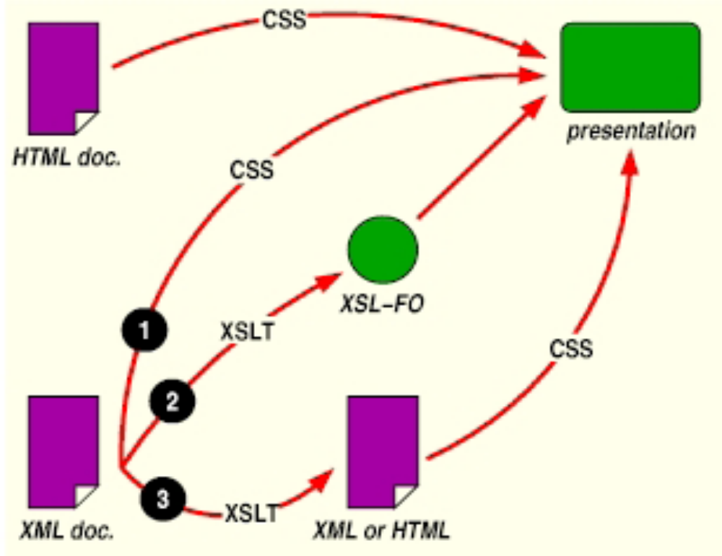

Slide 33
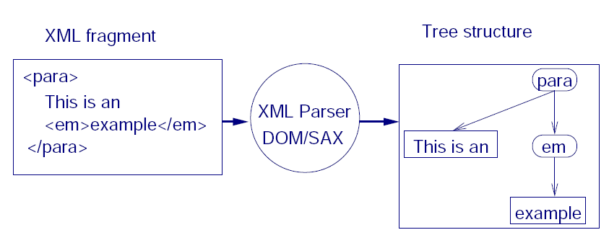
How XML data can be transformed using XSLT?
conversion of XML data into a tree structure, e.g. using an XML parser conformant to
{ Document Object Model (DOM)
{ Simple Api for XML (SAX)

Slide 34
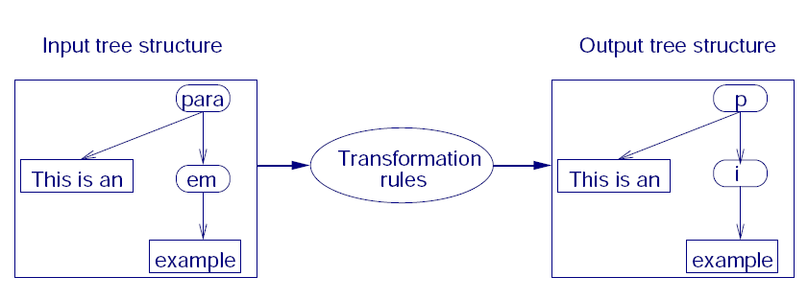
A structural transformation of the data: from the input to the desired output structure
{ involves selecting-projecting-joining, aggregating, grouping, sorting data.
{ XSLT vs. custom applications: factoring out common subtasks and present them as transformation rules in a high-level declarative language

Slide 35
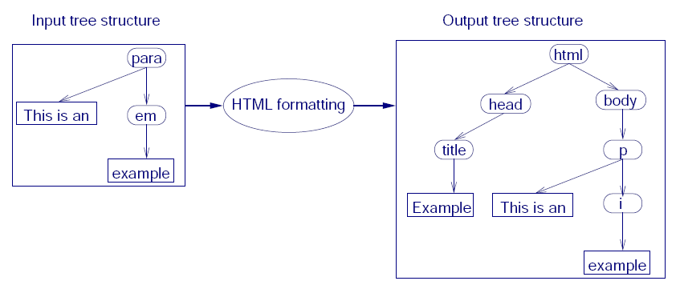
Formatting of the data: data in the desired output structure is enriched with target format constructs, e.g. from
PDF (paper-print), VoiceXML (aural presentations), SVG (graphics), HTML (browsing)

Slide 36
XSLT
Extensible Stylesheet Language Transformations
XSLT is used to transform one xml document into another, often an html document.
The Transform classes are now part of Java 1.4.
A program is used that takes as input one xml document and produces as output another.
If the resulting document is in html, it can be viewed by a web browser.
This is a good way to display xml data.

Slide 37
Parsers
There are two principal models for parsers.
SAX – Simple API for XML
  Uses a call-back method
  Similar to javax listeners
DOM – Document Object Model
  Creates a parse tree
  Requires a tree traversal

Slide 38
References
Elliotte Rusty Harold, Processing XML with Java, Addison Wesley, 2002.
Elliotte Rusty Harold and Scott Means, XML Programming, O’Reilly & Associates, Inc., 2002.
W3Schools Online Web Tutorials, http://www.w3schools.com.

